Slide 1
Computational News Project Proposal
Presented by
Chang Li
Ph.D. @ UBTECH Sydney AI Center,
University of Sydney,
CMCRC

Slide 2
Topics
System Overview
Corporation Knowledge Base
Clustering System
Market Surveillance System

Slide 3
System Overview
Corporation Knowledge Base
Entity Embeddings
Clustering
System
Maximum Clique
Unstructured
Documents
Corporation Action Documents
Market Surveillance
System
Real-time
Market Data
Financial Market
Data

Slide 4
Corporation Knowledge Base
Corporation Knowledge Base
Entity Embeddings
Corporation META Data
From Stock Exchange
(as Entities, Concepts)
Dis-ambiguation
Link Generation
Mention Detection
Unstructured Documents
Corporation Action Documents

Slide 5
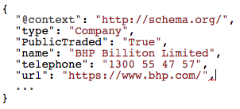
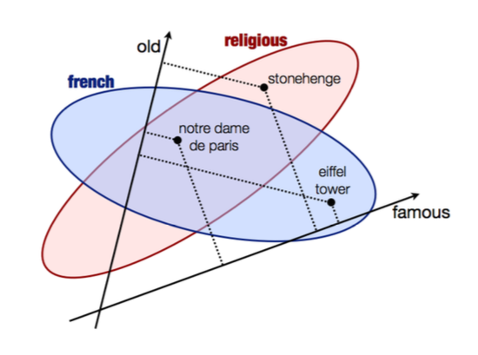
Corporation Knowledge Base: Embeddings
Entities
(With Links)
Embeddings
Embed Every Corporation Record into a Dense Vector

Slide 6
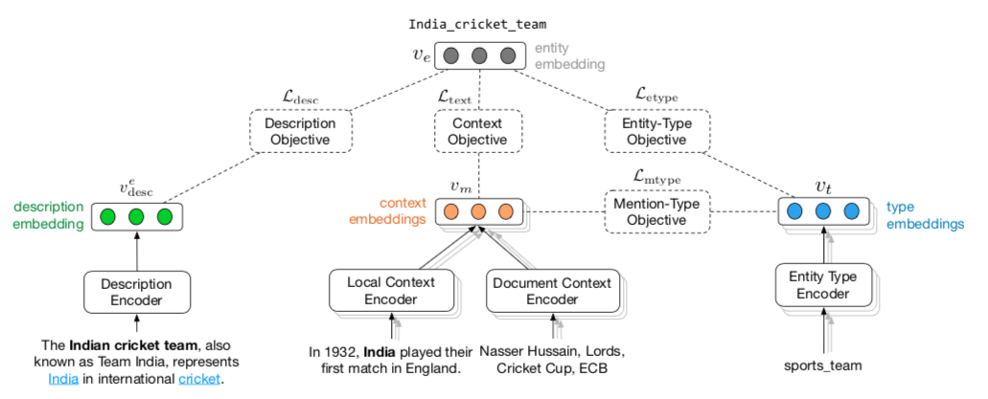
Corporation Knowledge Base: Embeddings

Slide 7
Topics
System Overview
Corporation Knowledge Base
Clustering System
Market Surveillance System

Slide 8
Clustering System
Entity Embeddings
Maximum Cliques
Clustering Algorithm
Each node is a corporation

Slide 9
Clustering System: Clustering Algorithm
Conventional Methodologies
GMM (K-means)
Super-pixel
SLIC
QuickShift
Knowledge Base Related
Fielded Sequential Dependence Model (FSDM) Ranking
Type-based Ranking
MRF Based Ranking

Slide 10
Topics
System Overview
Corporation Knowledge Base
Clustering System
Market Surveillance System

Slide 11
Market Surveillance System
Maximum Cliques
Markov Random Field
Graph
Financial Market
Data
Each node z is a corporation’s market price feature vector
Each node y is z’s latent label
Features

Slide 12
Market Surveillance System
What can we do from MRF?
Event Driven Price Movement Prediction
Latent Label Y is Positive / Negative Movement
Price Manipulation / Insider Trading Detection
Latent Label Y is Binary Label

Slide 13
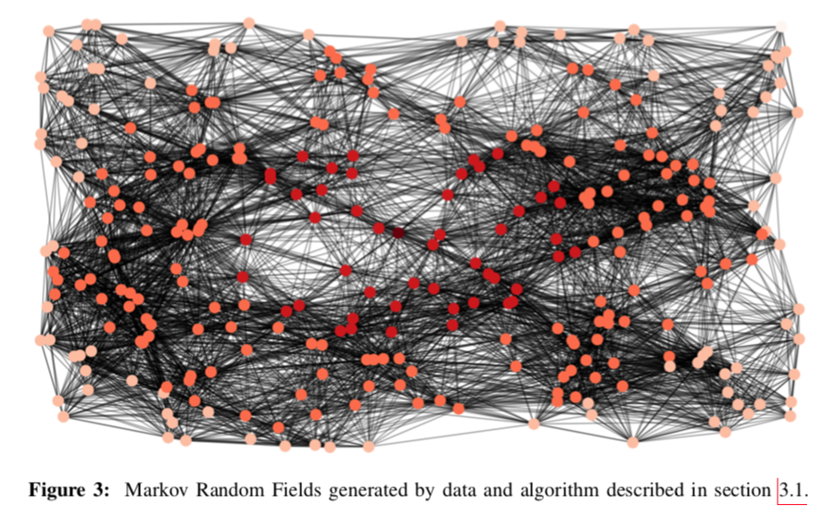
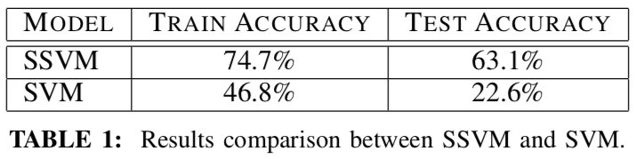
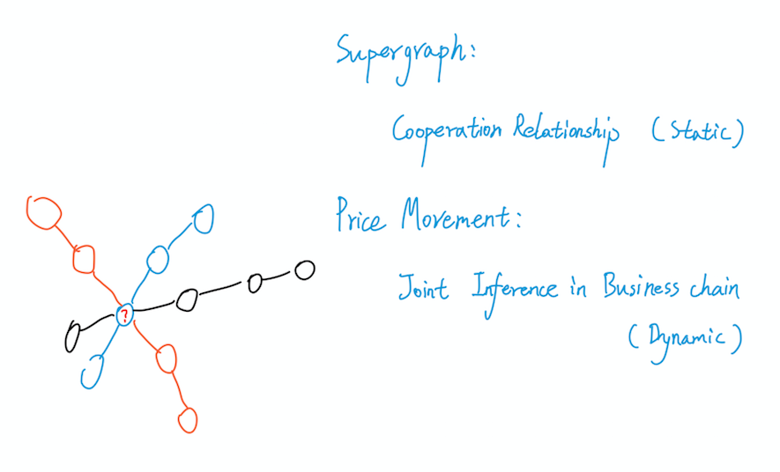
Market Surveillance System: Event Driven Price Prediction
ICDM 2017 OEDM Workshop Paper Lin Lai, Chang Li, Wen Long

Slide 14
Appendix: Corporation Knowledge Base

Slide 15
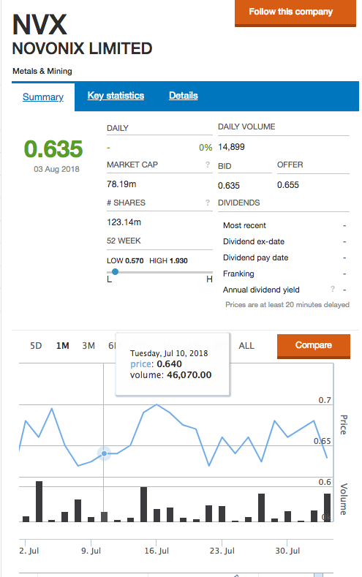
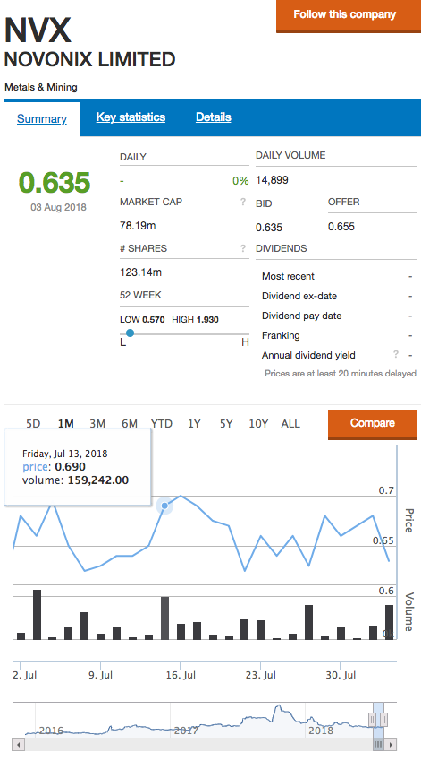
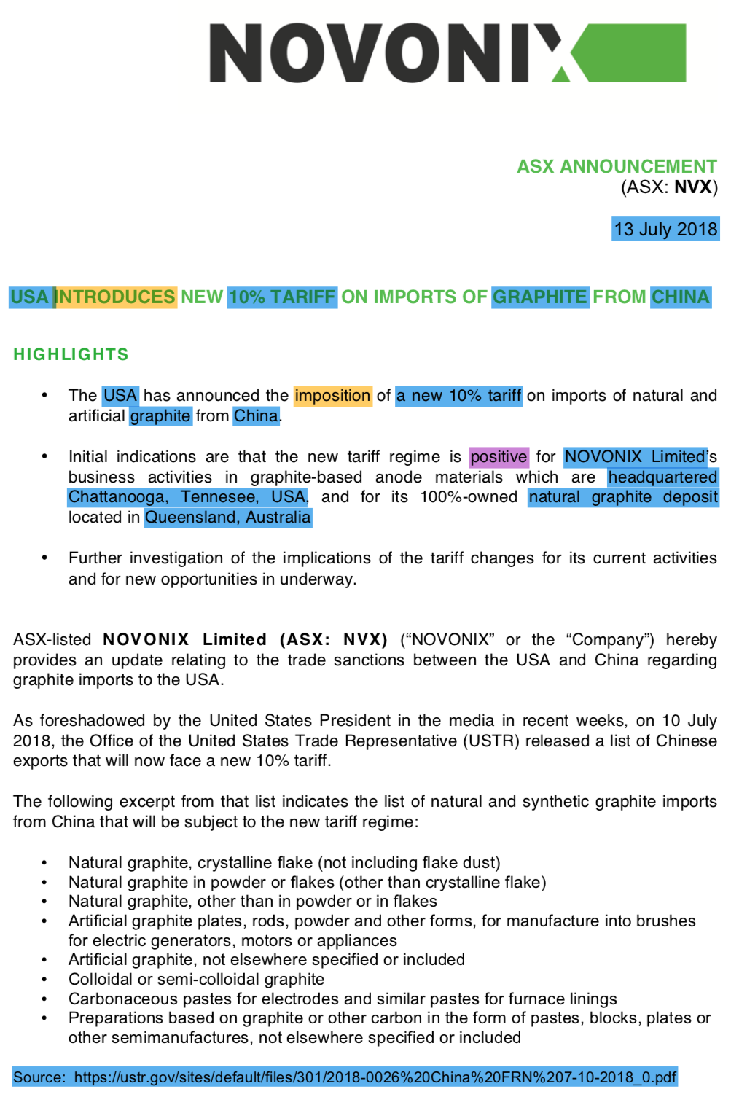
Appendix: Event Driven Trading

